Slide 1


Artificial Intelligence
Unit-3 (Predicate Logic, Resolution)
Artificial Intelligence
Department of Computer Engineering

Slide 2
First Order Predicate Logic (FOPL)
FOPL was developed to extend the expressiveness of Propositional logic.
Propositional logic works fine in situations where the result is either true or false. However, there are many real life situations that cannot be treated this way.
Predicate logic is the area of logic that deals with
predicates and quantifiers
Predicate – refers to a property that the subject of a statement can have
E.G. “x is greater than 3”
x → is the subject and
“is greater than 3” → is the predicate

Slide 3
Limitations of Propositional Logic
The propositional logic has its limitations that you cannot deal properly with general statements of the form
“All men are mortal”
You can not derive from the conjunction of this and “Socrates is a man” that “Socrates is mortal”
Example:
If All men are mortal = P
Socrates is a Man = Q
Socrates is mortal = R
Then (P & Q) → R is not valid

Slide 4
Syntax of FOPL
Connectives
Quantifiers
Constants
Variables
Predicates
Functions

Slide 5
Syntax of FOPL
Connectives: There are five connective symbols
~ : not or negation
& : and or conjuction
∨ : or or inclusive disjunction
→ : implication
↔ : equivalence or if and only if
Quantifiers: There are two quantifier symbols are
∃ : existential quantification
Example: ∃x means there exist x
∀ : universal quantification
Example: ∀x means for all x

Slide 6
Syntax of FOPL...
Constants: constants are fixed-values terms that belong to a given domain of discourse. They are denoted by numbers, words and small letter.
Variables: variables are terms that can assume different values over a given domain.

Slide 7
Syntax of FOPL...
Predicates: a predicate is defined as a relation that binds two atoms together. Ex: Rabbit likes carrots, is represented as
LIKES(rabit, carrots)
Here LIKES is a predicate that links two atoms “rabbit“ and “carrots“
Functions: it is also possible to have a function as an argument, e.g. “ Ravi„s father is Rani„s father“ is represented as-
FATHER(father(Ravi), Rani)
Here FATHER is a predicate and father(Ravi) is a function to
indicate Ravi„s father.

Slide 8
Syntax of FOPL...
Constants, variables, and functions are referred to as terms.
Predicates are referred to as atomic formulas or atoms.
When we want to refer to an atom or its negation, we often use the word literal.
In addition to above symbols, left and right parentheses , square brackets, braces, and the period are used for punctuation in symbolic representation.

Slide 9
Translating English to FOPL
Bhaskar likes aeroplanes.
Ravi‟s father is rani‟s
father.
Plato is a man
Ram likes mango.
Sima is a girl.
Rose is red.
John owns gold
Ram is taller than mohan
My name is khan
Apple is fruit.

Slide 10
Translating English to FOPL
Ram is male.
Tuna is fish.
Dashrath is ram‟s father.
Kush is son of ram.
Kaushaliya is wife of Dashrath.
Clinton is tall.
There is a white alligator.
All kings are person.
Nobody loves john.
Every one has a father.

Slide 11
Translating English to FOPL
Bhaskar likes aeroplanes.
Ravi‟s father is rani‟s
father.
Plato is a man.
Ram likes mango.
Sima is a girl.
Rose is red.
John owns gold.
Ram is taller than mohan.
My name is khan.
Apple is fruit.
Likes (bhaskar, aeroplanes). Father(father(ravi), rani )).
Man (plato). Likes(ram, mango). Girl(sima) .
Red (rose). Owns(john, gold). Taller(ram, mohan).
Name (khan) or Name(my, khan) Fruit(apple).

Slide 12
Translating English to FOPL
Ram is male.
Tuna is fish.
Dashrath is ram‟s father.
Kush is son of ram.
Kaushaliya is wife of Dashrath.
Clinton is tall.
There is a white alligator.
All kings are person.
Nobody loves john.
Every one has a father.
Male (ram). Fish (tuna).
Father (dashrath, ram). Son(kush, ram).
Wife(kaushaliya, dashrath).
Tall(clinton). Alligator (white).
∀x: Kings(x) → Person(x).
∀x: ¬Loves(x, john).
∀x: ∃y: Father(y,x)

Slide 13
Translate into predicate logic
Marcus was a man.
Marcus was a Pompeian.
All Pompeians were Romans.
Caesar was a ruler.
All Romans were either loyal to Caesar or hated him.
Everyone is loyal to someone.
People only try to assassinate rulers they aren't loyal to.
Marcus tried to assassinate Caesar.
All men are people.

Slide 14
Solution
Marcus was a man.
Man(Marcus).
Marcus was a Pompeian.
Pompeian(marcus)
All Pompeian were Romans.
∀x: Pompeian(x) → Roman(x)
Caesar was a ruler.
Ruler(Caesar)
All Romans were either loyal to Caesar or hated him.
∀x: Roman(x) → LoyalTo(x,Caesar) ∨ Hate(x,Caesar)

Slide 15
Solution
Everyone is loyal to someone.
∀x: ∃y: LoyalTo(x,y)
People only try to assassinate rulers they aren't loyal to.
∀x: ∀y: Person(x) ^ Ruler(y) ^ TryAssassinate(x,y) →¬LoyalTo(x,y)]
Marcus tried to assassinate Caesar. TryAssassinate(Marcus, Caesar)
All men are people.
∀x: Men(x) → People(x)

Slide 16
Translate into predicate logic
Hari likes all kind of food.
Bananas are food.
Apples are food.
Anything anyone eats and isn‟t killed by food.
Hari eats everything ram eats.

Slide 17
Solution
∀x: Food(x) → Likes(hari, x).
Food(bananas) .
Food(apples) .
∀x: ∃y: Eats(y,x) ^ ¬Killedby(y,x) →Food(x)
∀x: eats(ram, x) → eats(hari, x) .

Slide 18
Translating English to FOPL
Every gardener likes the sun.
Not Every gardener likes the sun.
You can fool some of the people all of the time.
You can fool all of the people some of the time.
You can fool all of the people at same time.
You can not fool all of the people all of the time.
Everyone is younger than his father.

Slide 19
Solution
(∀x): gardener(x) => likes(x, Sun)
~((∀x) :gardener(x) => likes(x, Sun))
(∃x):(∀t) :person(x) ^ time(t) => can-be-fooled(x, t)
(∀x):(∃t) :person(x) ^ time(t) => can-be-fooled(x ,t)
(∃t):(∀x) :person(x) ^ time(t) => can-be-fooled(x, t)
~((∀x):(∀t): person(x) ^ time(t) => can-be-fooled(x, t))
(∀x) :person(x) => younger(x, father(x))

Slide 20
Translating English to FOPL
All purple mushrooms are poisonous.
No purple mushroom is poisonous.
There are exactly two purple mushrooms.
Clinton is not tall.
X is above Y if X is directly on top of Y or there is a pile of one or more other objects directly on top of one another starting with X and ending with Y.
no one likes everyone

Slide 21
Solution
(∀x): (mushroom(x) ^ purple(x)) => poisonous(x)
~(∃x): purple(x) ^ mushroom(x) ^ poisonous(x)
(∀x): (mushroom(x) ^ purple(x)) => ~poisonous(x)
(∃x):(∃y): mushroom(x) ^ purple(x) ^ mushroom(y) ^ purple(y) ^ ~(x=y) ^
~tall(Clinton)
(∀z) :(mushroom(z) ^ purple(z)) => ((x=z) v (y=z))
(∀x):(∀y): above(x,y) <=> (on(x,y) v (∃z) (on(x,z) ^ above(z,y)))
6. ~ (∃x):(∀y):likes(x,y) or (∀x):(∃y):~likes(x,y)

Slide 22
Skolemization
Skolemization is
the process of replacement of
existential quantified variable with Skolem function and deletion of the respective quantifiers.
Skolem function is arbitrary functions which can always assume a correct value required of an existentially quantified variable.
Example
∃x : President(x)
Can be transformed into the formula
President(P1)
Where P1 is a function with no arguments that somehow produces a value that satisfies president.

Slide 23
Example 1
Everybody loves somebody.
∀x: ∃ y: (Person(x) ^ Person(y)) →Loves(x,y)] Converted to
∀x: (Person(x) ^ Person f(x)) →Loves(x,f(x))] Where f(x) specifies the person that x loves.

Slide 24
Clausal Form
A formula is said to be in clausal form if it is of the form:
∀x₁ ∀x₂ … ∀x_{n} [C₁ 𝖠 C₂ 𝖠 … 𝖠 C_{k}]. „
All first-order logic formulas can be converted to clausal
form.

Slide 25
Equivalent Logical Expressions
i. ~(~F) = F
ii. F & G = G & F, F V G = G V F iii.
iv.
(Double Negation) (Commutativity)
(F & G) & H = F & (G & H), (F V G) V H = F V (G V H) (Associativity)
F V (G & H) = (F V G) & (F V H), F & (G V H) = (F & G) V (F & H)
(Distributivity)
v.
vi.
~(F & G) = ~F V ~G, ~(F V G) = ~F & ~G (De Morgan) F → G = ~F V G
F ↔ G = (~F V G) & (~G V F)
∀x F[x] V G = ∀x (F[x] V G )
∃x F[x] V G = ∃x (F[x] V G )
x. ∀x F[x] & G = ∀x (F[x] & G )
xi. ∃x F[x] & G = ∃x (F[x] & G )

Slide 26
Equivalent Logical Expressions...
xii. ~(∀x) F[x] = ∃x (~F[x])
~(∃x) F[x] = ∀x (~F[x])
∀x F[x] & ∀x G[x] = ∀x (F[x] & G[x])
xv. ∃ x F[x] & ∃ x G[x] = ∃ x (F[x] & G[x])

Slide 27
Conversion to Clausal form or Conjunctive Normal Form (CNF)
Eliminate logical implications, ⇒, using the fact that A ⇒ B is equivalent to ¬A ∨ B.
Reduce the scope of each negation to a single term, using the following facts:
¬(¬P) = P
¬(A ∨ B) = ¬A 𝖠 ¬B
¬(A 𝖠 B) = ¬A V ¬B
¬∀x: P(x) = ∃x: ¬P(x)
¬∃x: P(x) = ∀x: ¬P(x)
Standardize variables so that each quantifier binds a unique variable.
Move all quantifiers to the left, maintaining their order.
Eliminate existential quantifiers, using Skolem functions (functions of the preceding universally quantified variables).
Drop the prefix; assume universal quantification.
Convert the matrix into a conjunction of disjunctions. [(a &b) or c=(a or c) & (b or c)
Create a separate clause corresponding to each conjunction.
Standardize apart the variables in the clauses.

Slide 28
Example of Clausal Conversion
∃x ∀y (∀z P(f(x), y, z) → (∃u Q(x, u) & ∃v R(y, v)))
Step 1: Eliminate logical implications
– ∃x ∀y (~(∀z) P(f(x), y, z) V (∃u Q(x, u) & ( ∃v) R(y, v)))
Step 2: Reduce the scope of each negation to a single term
– ∃x ∀y (∃z ~P(f(x), y, z) V (∃u Q(x, u) & (∃v) R(y, v)))
Step 3:
– It is not require here because quantifiers have different variable assignments.
Step 4: Move all quantifiers to the left
– ∃x ∀y ∃z ∃u ∃v (~P(f(x), y, z) V (Q(x, u) & R(y, v)))
Step 5: Skolem functions
– ∀y(~P f(x) , y, g(y)) V Q(a, h(y)) & R(y, l(y))
Step 6: Drop the prefix
– (~P f(x) , y, g(y)) V Q(a, h(y)) & R(y, l(y))

Slide 29
Example of Clausal Conversion
Step 7: Convert the matrix into a conjunction of disjunctions
– ((~P f(x) , y, g(y)) V Q(a, h(y)) &( ~P f(x) , y, g(y)) V R(y, l(y)))
Step 8:
– (~P f(x) , y, g(y)) V Q(a, h(y))
– ( ~P f(x) , y, g(y)) V R(y, l(y)))
Step 9: Standardize apart the variables in the clauses

Slide 30
Translate into Clausal form
Hari likes all kind of food.
Bananas are food.
Apples are food.
Anything anyone eats and isn‟t killed by food.
Hari eats everything ram eats.

Slide 31
Convert it into clausal form
∀x: Food(x) → Likes(hari, x).
Food(bananas) .
Food(apples) .
∀x: ∃y: Eats(y,x) ^ ¬Killedby(y,x) →Food(x)
∀x: Eats(ram, x) → Eats(hari, x) .

Slide 32
Solution
¬ Food(x) ∨ Likes(hari, x).
Food(bananas) .
Food(apples) .
¬ Eats(y,x) ∨ Killedby(y,x) ∨ Food(x)
¬ Eats(ram, x) ∨ eats(hari, x) .

Slide 33
Convert it into FOPL
All lectures are determined.
∀x: Lecturer(x) → Determined(x)
Any one who is determined and intelligent will give good service.
∀x: Determined(x) ^ Intelligent(x)→Givegoodservice(x)
iii.
Mary is an intelligent lecturer. Lecturer(mary) Intelligent(mary)

Slide 34
Convert FOPL into clausal form
i. All lectures are determined.
∀x: Lecturer(x) → Determined(x)
¬ Lecturer(x) ∨ Determined(x)
i. Any one who is determined and intelligent will give good service.
∀x: Determined(x) ^ Intelligent(x)→Givegoodservice(x)
¬ Determined(x) ∨ ¬ Intelligent(x) ∨ Givegoodservice(x) Mary is an intelligent lecturer.
Lecturer(mary) Intelligent(mary) (Both are same)
iii.

Slide 35
Example of FOPL
Marcus was a man.
Man(Marcus).
Marcus was a Pompeian.
Pompeian(marcus)
All Pompeian were Romans.
∀x: Pompeian(x) → Roman(x)
Caesar was a ruler.
Ruler(Caesar)
All Romans were either loyal to Caesar or hated him.
∀x: Roman(x) → LoyalTo(x,Caesar) ∨ Hate(x,Caesar)

Slide 36
Example of FOPL
Everyone is loyal to someone.
∀x: ∃y: LoyalTo(x,y)
People only try to assassinate rulers they aren't loyal to.
∀x: ∀y: Person(x) ^ Ruler(y) ^ TryAssassinate(x,y) →¬LoyalTo(x,y)]
Marcus tried to assassinate Caesar. TryAssassinate(Marcus, Caesar)
All men are people.
∀x: Men(x) → People(x)

Slide 37
Prove this
Given the above sentences, can we make a conclusion as follows:
“Marcus was not loyal to Caesar ?” or:
¬loyalto(Marcus,Caesar)
Solution:
In order to prove the goal, we need to use the rules of inference to transform it into another goal that can in turn be transformed, and so on, until there are no unsatisfied goals remaining.

Slide 38
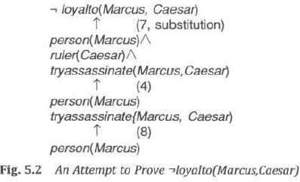
Solution

Slide 39
Unification
Any substitution that makes two or more expression equal
is called a unifier for the expression.
Two formulas unify if they can be made identical.
A unification is a function that assigns bindings to variables.
A binding is either a constant, a functional expression or
another variable.

Slide 40
Unification process
The basic idea of unification is very simple.
To attempt to unify two literals, we first check if their initial
predicate symbols are the same. If so, we can proceed.
Otherwise, there is no way they can be unified, regardless of their arguments. For example, the two literals
tryassassinate (Marcus, Caesar)
hate(Marcus, Caesar)
cannot be unified.
If the predicate symbols match, then we must check the arguments, one pair at a time. If the first matches, we can continue with the second, and so on.

Slide 41
 |  | Example
P(x, x) | P(A,A) |  | {x/A}
P(x, x) | P(A,B) |  | fail
P(x, y) | P(A,B) |  | {x/A, y/B}
P(x, y) | P(A,A) |  | fail
P(x, y) | P(A, z) |  | {x/A, y/z}
P(f(x),y)P(f(A),B) {x/A, y/B}
P(x, y) | P(f(x),B) |  | fail
P(x, y) | P(z, f(z)) |  | {x/z, y/f(z)}

Slide 42
Unification algorithm
Unify(L1, L2) returns a list representing the composition of the substitutions that were performed during the match.
The empty list, NIL, indicates that a match was found without any substitutions.
The list consisting of the single value FAIL indicates that the unification procedure failed.
The final substitution produced by the unification process will be used by the resolution procedure.

Slide 43
Unification algorithm
Algorithm: Unify(L1, L2)
If L1 or L2 are both variables or constants, then:
If L1 and L2 are identical, then return NIL.
Else if L1 is a variable, then if L1 occurs in L2 then return {FAIL}, else return
(L2/L1).
Else if L2 is a variable, then if L2 occurs in L1 then return {FAIL} , else return
(L1/L2).
Else return {FAIL}.
If the initial predicate symbols in L1 and L2 are not identical, then return {FAIL}.
If LI and L2 have a different number of arguments, then return {FAIL}.
Set SUBST to NIL. (At the end of this procedure, SUBST will contain all the substitutions used to unify L1 and L2.)
For i ← 1 to number of arguments in L1 :
Call Unify with the ith argument of L1 and the ith argument of L2, putting result
in S.
If S contains FAIL then return {FAIL}.
If S is not equal to NIL then:
Apply S to the remainder of both L1 and L2.
^{SUBST: = APPEND(S,SUBSET)}
6. Return SUBST.

Slide 44
Solve
(Unification) For
each pair of atomic
sentences, give the most general unifier if it exists, otherwise say “fail”:
R(A, x), R(y, z)
P(A, B, B), P(x, y, z)
c. Q(y, G(A, B)), Q(G(x,x), y)
d. Older(Father(y), y), Older(Father(x), John)
e. Knows(Father(y),y), Knows(x,x)

Slide 45
Solution
(Unification) For each pair of atomic sentences, give the most general unifier if it exists, otherwise say “fail”:
R(A, x), R(y, z)
P(A, B, B), P(x, y, z)
c. Q(y, G(A, B)), Q(G(x,x), y)
y/A, x/z x/A, y/B, z/B
fail
d. Older(Father(y), y), Older(Father(x),
x/y, y/John
e. Knows(Father(y),y), Knows(x,x)
John)
fail

Slide 46
Resolution Principle
Given two clauses C₁ and C₂ with no variables in common, if there is a literal l₁, in C₁ and which is a complement of a literal l₂ in C₂ , both l₁ and l₂ are deleted and a disjuncted C is formed the remaining reduced clauses. The new clauses C is called the resolve of C₁ and C₂.
Resolution is the process of generating these resolvents from the set of clauses.
Example: (~ PVQ) and (~Q V R)
We can write
(~ PVQ) , (~Q V R)
~P V R

Slide 47
Refutation
Resolution produces proofs by refutation.
In other words, to prove a statement, resolution attempts to show that the negation of the statement produces a contradiction with the known statements.

Slide 48
Example of Resolution
Consider the following clauses:- A : P V Q V R
B: ~ P V Q V R
C: ~Q V R
Solution
A: P V Q V R B : ~P V Q V R D : Q V R
C: ~Q V R E: R
(Given in the problem) (Given in the problem) (Resolvent of A and B) (Given in the problem) (Resolvent of C and D)

Slide 49
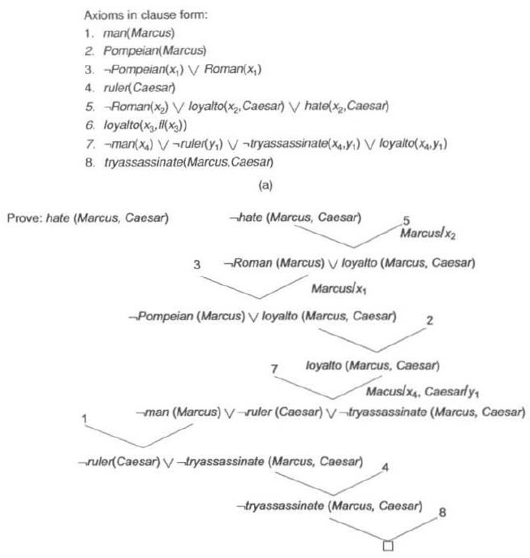

Slide 50
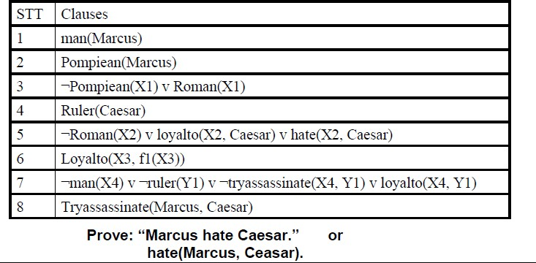
Example of resolution

Slide 51
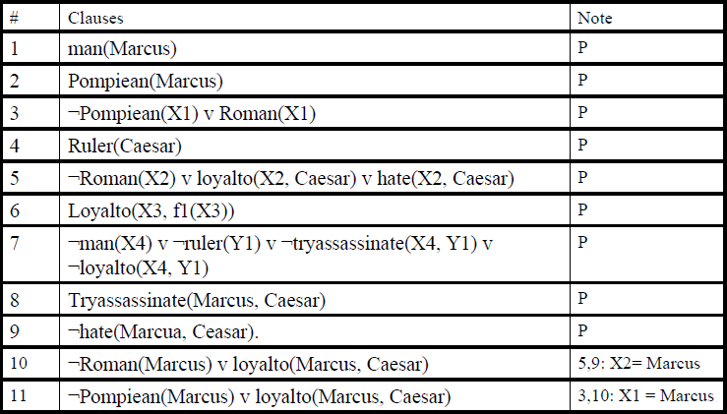
Solution

Slide 52
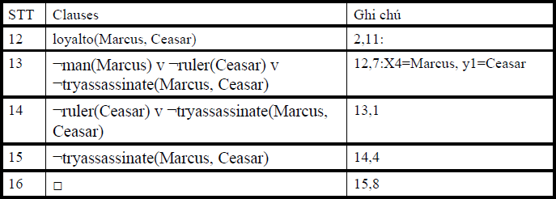
Solution

Slide 53
Example
Assume the following facts:
“Steve only likes easy courses.
Science courses are hard.
All the courses in Humanities Department are easy.
HM101 is a course in Humanities”.
Convert the above statements into appropriate wffs so that the resolution can be performed to answer the question. “ what course would steve like?”

Slide 54
Solution
First we will convert it into FOPL (First order predicate logic)
“Steve only likes easy courses.
∀x: easy(x) -> likes(steve,x)
Science courses are hard.
∀x: science(x) -> ~easy(x)
All the courses in Humanities Department are easy.
∀x: humanities(x) -> easy(x)
HM101 is a course in Humanities”. humanities(HM101)
The conclusion is encoded as likes(steve , x).

Slide 55
Solution continued….
First we put our premises in the clause form and the negation of conclusion to our set of clauses (we use numbers in parentheses to number the clauses):
~easy(x) ∨ likes(steve,x)
~science(x) ∨ ~easy(x)
~humanities (x) ∨ easy(x)
humanities(HM101)
~likes(steve,x)

Slide 56
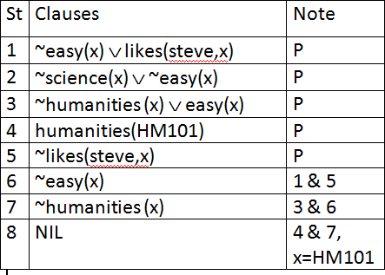
Solution continued….

Slide 57
¬ likes(steve,x) ¬ easy(x) ∨ likes(steve,x)
¬ easy(x) ←resolvent
¬ Humanities(x) ∨ easy(x)
Humanities(HM101)
¬Humanities(x)
HM101/X

Slide 58
Solution continued….
A resolution proof may be obtained by the following sequence of resolutions
(6) 1&5 yields resolvent ~easy(x).
(7) 3&6 yields resolvent ~humanities (x).
(8) 4&7 yields empty clause; the substitution x/HM101 is produced by the unification algorithm which says that the only wff of the form likes(steve,x) which follows from the premises is likes(steve, HM101). Thus, resolution gives us a way to find additional assumptions.

Slide 59
Example
Problem Statement:
Ravi likes all kind of food.
Apples and chicken are food
Anything anyone eats and is not killed is food
Ajay eats peanuts and is still alive
Rita eats everything that Ajay eats.
Prove by resolution that Ravi likes peanuts using resolution.

Slide 60
Solution
Step 1: Converting the given statements into Predicate/Propositional Logic
∀x : food(x) → likes (Ravi, x)
food (Apple) ^ food (chicken)
∀a : ∀b: eats (a, b) ^ killed (a) → food (b)
eats (Ajay, Peanuts) ^ alive (Ajay)
∀c : eats (Ajay, c) → eats (Rita, c)
∀d : alive(d) → ~killed (d)
∀e: ~killed(e) → alive(e) Conclusion: likes (Ravi, Peanuts)

Slide 61
Solution continued…
Step 2: Convert into CNF
~food(x) v likes (Ravi, x)
Food (apple)
Food (chicken)
~ eats (a, b) v killed (a) v food (b)
Eats (Ajay, Peanuts)
Alive (Ajay)
~eats (Ajay, c) V eats (Rita, c)
~alive (d) v ~ killed (d)
Killed (e) v alive (e)
_{Conclusion: likes}Pre₍p_{R}ared_{a}by_{v}- A_{i}g,niw_{P}esh_{e}M_{a}ish_{n}ra, R_{u}un_{t}gt_{s}a ₎

Slide 62
Solution continued…
Step 3: Negate the conclusion
~ likes (Ravi, Peanuts)
Step 4: Resolve using a resolution tree

Slide 63
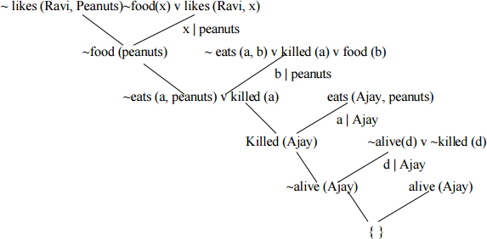
Solution continued…
Hence we see that the negation of the conclusion has been proved as a complete contradiction with the given set of facts. Hence the negation is completely invalid or false or the assertion is completely valid or true.

Slide 64
Using Propositional Logic
Representing simple facts
It is raining
RAINING
It is sunny
SUNNY
It is windy
WINDY
If it is raining, then it is not sunny
RAINING → ¬SUNNY

Slide 65
Using Predicate Logic
Represent the facts in logic
Marcus was a man.
2. Marcus was a Pompeian.
3. All Pompeians were Romans.
4. Caesar was a ruler.
All Pompeians were either loyal to Caesar or hated him.
6. Every one is loyal to someone.
People only try to assassinate rulers they are not loyal to.
Marcus tried to assassinate Caesar.

Slide 66
Using Predicate Logic
Marcus was a man.
man(Marcus)

Slide 67
Using Predicate Logic
2. Marcus was a Pompeian.
Pompeian(Marcus)

Slide 68
Using Predicate Logic
3. All Pompeians were Romans.
∀x: Pompeian(x) → Roman(x)

Slide 69
Using Predicate Logic
4. Caesar was a ruler.
ruler(Caesar)

Slide 70
Using Predicate Logic
All Pompeians were either loyal to Caesar or hated him.
inclusive-or
∀x: Roman(x) → loyalto(x, Caesar) ∨ hate(x, Caesar)
exclusive-or
∀x: Roman(x) → (loyalto(x, Caesar) ∧ ¬hate(x, Caesar)) ∨
(¬loyalto(x, Caesar) ∧ hate(x, Caesar))

Slide 71
Using Predicate Logic
6. Every one is loyal to someone.
∀x: ∃y: loyalto(x, y) ∃y: ∀x: loyalto(x, y)

Slide 72
Using Predicate Logic
People only try to assassinate rulers they are not loyal to.
∀x: ∀y: person(x) ∧ ruler(y) ∧ tryassassinate(x, y)
→ ¬loyalto(x, y)

Slide 73
Using Predicate Logic
Marcus tried to assassinate Caesar.
tryassassinate(Marcus, Caesar)

Slide 74
Using Predicate Logic
Was Marcus loyal to Caesar?
man(Marcus)
ruler(Caesar)
tryassassinate(Marcus, Caesar)
⇓ ∀x: man(x) → person(x)
¬loyalto(Marcus, Caesar)

Slide 75
Using Predicate Logic
Many English sentences are ambiguous.
There is often a choice of how to represent knowledge.
Obvious information may be necessary for reasoning
We may not know in advance which statements to deduce (P or ¬P).

Slide 76
Reasoning
1. Marcus was a Pompeian.
2. All Pompeians died when the volcano erupted in 79 A.D.
3. It is now 2008 A.D.
Is Marcus alive?

Slide 77
Reasoning
Marcus was a Pompeian.
Pompeian(Marcus)
All Pompeians died when the volcano erupted in 79 A.D.
erupted(volcano, 79) ∧ ∀x: Pompeian(x) → died(x, 79)
3. It is now 2008 A.D.
now = 2008

Slide 78
Reasoning
Marcus was a Pompeian.
Pompeian(Marcus)
All Pompeians died when the volcano erupted in 79 A.D.
erupted(volcano, 79) ∧ ∀x: Pompeian(x) → died(x, 79)
3. It is now 2008 A.D.
now = 2008
∀x: ∀t₁: ∀t₂: died(x, t₁) ∧ greater-than(t₂, t₁) → dead(x, t₂)

Slide 79
Resolution
Resolution produces proofs by refutation(i.e. To prove statement)
The basic ideas
KB |= α ⇔ KB ∧ ¬α |= false
(α ∨ ¬β) ∧ ( γ ∨ β) ⇒ (α ∨ γ)
sound and complete

Slide 80
Conversion to Clause Form
Eliminate →.
P → Q ≡ ¬P ∨ Q
Reduce the scope of each ¬ to a single term.
¬(P ∨ Q) ≡ ¬P ∧ ¬Q
¬(P ∧ Q) ≡ ¬P ∨ ¬Q
¬∀x: P ≡ ∃x: ¬P
¬∃x: p ≡ ∀x: ¬P
¬¬ P ≡ P
Standardize variables so that each quantifier binds a unique variable.
(∀x: P(x)) ∨ (∃x: Q(x)) ≡ (∀x: P(x)) ∨ (∃y: Q(y))

Slide 81
Conversion to Clause Form
Move all quantifiers to the left without changing their relative order.
(∀x: P(x)) ∨ (∃y: Q(y)) ≡ ∀x: ∃y: (P(x) ∨ (Q(y))
Eliminate ∃ (Skolemization).
∃x: P(x) ≡ P(c) Skolem constant
∀x: ∃y P(x, y) ≡ ∀x: P(x, f(x)) Skolem function
Drop ∀.
∀x: P(x) ≡ P(x)
Convert the formula into a conjunction of disjuncts.
(P ∧ Q) ∨ R ≡ (P ∨ R) ∧ (Q ∨ R)
8. Create a separate clause corresponding to each conjunct.
9. Standardize apart the variables in the set of obtained clauses.

Slide 82
Resolution in Propositional Logic
1. Convert all the propositions of KB to clause form (S).
2. Negate α and convert it to clause form. Add it to S.
Repeat until either a contradiction is found or no progress can be made.
Select two clauses (α ∨ ¬P) and ( γ ∨ P).
Add the resolvent (α ∨ γ) to S.

Slide 83
Resolution in Propositional Logic
Example: given the Axioms Prove R
Given Axioms converted to Clause form
P P (1)
(P ∧ Q) → R, ¬P V ¬Q V R (2)
(S ∨ T) → Q, ¬ S V Q (3)
¬T V Q (4)
T T

Slide 84
¬P V ¬Q V R ¬R
¬P V ¬Q
P
¬T V Q
¬Q
T
¬T

Slide 85
Unification
UNIFY
To unify P(x,x), P(x,y) y/x substitute y for x
(knows(John, x), knows(John, Jane)) = {Jane/x}
UNIFY(knows(John, x), knows(y, mother(y))) = {John/y, mother(John)/x}
UNIFY(knows(John, x), knows(x, Elizabeth)) = FAIL

Slide 86
Algorithm :Unify(L1,L2)
If L1 or L2 are both variables or constants, then
(a) If L1 and L2 are identical, then return NIL
(b) Else if L1 is a variable, then if L1 occurs in L2 then return {FAIL}, else return (L2/L1).
(C) Else if L2 is a variable then if L2 occurs in L1 then return {FAIL},else return (L1/L2).
(d) Else return {FAIL}.
If the initial predicate symbols in L1 and are not identical, then return {FAIL}.

Slide 87
If L1 and L2 have a different number of arguments, then return {FAIL}.
Set SUBST to NIL.
For i←1 to number of arguments in L1
(a) Call Unify with ith argument of L1 and the ith argument of L2 ,put result in S
(b) If S contain FAIL then return {FAIL}
(c) If S is not equal to NIL then
i Apply S to remainder of both L1 and L2
ii SUBST:= APPEND(S,SUBST)
6. Return SUBST.

Slide 88
Resolution in predicate Logic
Resolve two clauses
1. man(Marcus)
2. ¬man(x1) V mortal(x1)
two clauses can be unified substitute Marcus/x1
man(Marcus) ¬man(Marcus) ← parent clause
mortal(Marcus) ←Resolvent

Slide 89
Resolution Algorithm
F is set of given statements
We want to prove statement P

Slide 90
Convert All the statements of F to Clause Form
Negate P and Convert it into Clause Form
Repeat Until either Contradiction is found or no progress can be made
(a) Select two clauses call them parent clauses
(b) Resolve them together
if pair of literals T1 and ¬T2, one parent clause contain T1 and other contain ¬T2
T1 and T2 are Unifiable
(C) If the resolvent is empty then contradiction has been found ,other repeat the procedure

Slide 91
Example
Assume Following facts and give the Answer of the Question
Is Marcus hate Caesar? Using Resolution
1. Marcus was a man.
2. Marcus was a Pompeian.
3. All Pompeians were Romans.
4. Caesar was a ruler.
All Pompeians were either loyal to Caesar or hated him.
6. Every one is loyal to someone.
People only try to assassinate rulers they are not loyal to.
Marcus tried to assassinate Caesar.

Slide 92
Example
Axioms in Clause Form
Man(Marcus).
2. Pompeian(Marcus).
3. ¬ Pompeian(x1) V Roman(x1).
4. ruler(Caesar).
¬Roman(x2) V loyalto(x2, Caesar) ∨ hate(x2, Caesar).
loyalto(x3, f1(x3)).
7. ¬ man(x4) ∧ ¬ ruler(y1) ∧ ¬ tryassassinate(x4, y1) V ¬ loyalto(x4, y1).
8. tryassassinate(Marcus, Caesar).

Slide 93
Example
Prove: hate(Marcus, Caesar)
¬ hate(Marcus, Caesar) 5 Marcus/x2
3 ¬Roman(Marcus) V loyalto(Marcus, Caesar)
Marcus/x1
2
¬ Pompeian(Marcus) V loyalto(Marcus, Caesar)
7
loyalto(Marcus, Caesar)

Slide 94
loyalto(Marcus, Caesar)
Marcus/x4,Caesar/y1
¬ man(Marcus) V ¬ ruler(Caesar) V ¬ tryassassinate(Marcus, Caesar)
1
¬ ruler(Caesar) V ¬ tryassassinate(Marcus, Caesar)
4
¬ tryassassinate(Marcus, Caesar)
8
A Resolution Proof

Slide 95
Use resolution to prove marcus is not alive now
Marcus was a man.
2. Marcus was a Pompeian.
3. Marcus was born in 40 A.D.
4. All men are mortal.
5. All Pompeians died when the volcano
erupted in 79 A.D.
6. No mortal lives longer than 150 years.
7. It is now 1991 A.D.

Slide 96
Question Answering
When did Marcus die?
Whom did Marcus hate?
3. Who tried to assassinate a ruler?
4. What happen in 79 A.D.?.
5. Did Marcus hate everyone?

Slide 97
Use Resolution to prove john likes Peanuts
1 John likes all kinds of food.
2 Apples are food.
3 Banana is food.
4 Anything anyone eats and isn’t killed by is food.
5 Bill eats peanuts and is still alive.
6 Sue eats everything Bill eats.

Slide 98
Solution :
covert sentences into logic
1.∀x :food(x) → likes(John , x)
2.food(apples)
3.food(banana)
4.∀x ∀y eats(y , x) ∧ alive(y) → food(x)
5.∀x eats(Bill , x) ∧ alive(Bill)
6.∀x eats(Bill , x) → eats(Sue , x)
7. ¬ likes(John , peanuts)

Slide 99
Convert logic form into clause form
1. ¬ food(x) ∨ likes(John , x)
2.food(apples)
3.food(banana)
4. ¬ eats(y , z) ∨ ¬ alive(y) ∨ food(z)
5.eats(Bill , peanuts)
6.alive(Bill)
7. ¬ eats(bill , w) ∨ eats(Sue , w)
8. ¬ likes(John , peanuts)

Slide 100
Use resolution to answer the question, “What food does Sue eat?”
What food does Sue eat?”
Eats(Sue,X),
Negate Query ¬ Eats(Sue, X)
¬ Eats(Sue, X) Eats(Bill,peanuts)
¬ Eats(Sue,peanuts)
P eanuts/x

Slide 101
Prove that john likes peanuts using backward chaining
Forward chaining : attempt to from start state
Backward chaining : attempt to prove from goal state

Slide 102
Use backward chaining to prove that John likes peanuts.
To prove Likes(John, Peanuts),
we just need to prove Food(Peanuts), according to sentence 1.
By sentence 4, we just need to prove
Eats(y, Peanuts) ∧ ¬KilledBy(y, Peanuts) V food(Penuts).

Slide 103
the following statements are assumed to be true:
Steve only likes easy courses.
Science courses are hard.
All the courses in the basketweaving department are easy.
BK301 is a basketweaving course.
Using Resolution find the Answer
What course would Steve like?

Slide 104
Convert sentences into predicate logic
∀x easy(x) -> likes(steve,x)
∀x science(x) -> ¬ easy(x)
∀x basketweaving(x) -> easy(x)
basketweaving(BK301)

Slide 105
First convert it into clause form
Negation of conclusion to our set of clauses

Slide 106
(1) ¬ easy(x) ∨ likes(steve,x)
(2) ¬ science(x) ∨ ¬ easy(x)
(3) ¬ science(x) ∨ ¬ easy(x)
(4) ¬ basketweaving(x) ∨ easy(x)
(5) basketweaving(BK301)
(6) ¬ likes(steve,x)

Slide 107
¬ likes(steve,x) ¬ easy(x) ∨ likes(steve,x)
¬ easy(x) ←resolvent
¬ basketweaving(x) ∨ easy(x)
basketweaving(BK301)
¬ basketweaving(x)
BK301/X

